Slide 1
The Disappearing Session
or
The Paradox of High Fidelity
Associate professor Tore Simonsen
Norwegian Academy of Music, Oslo

Slide 2
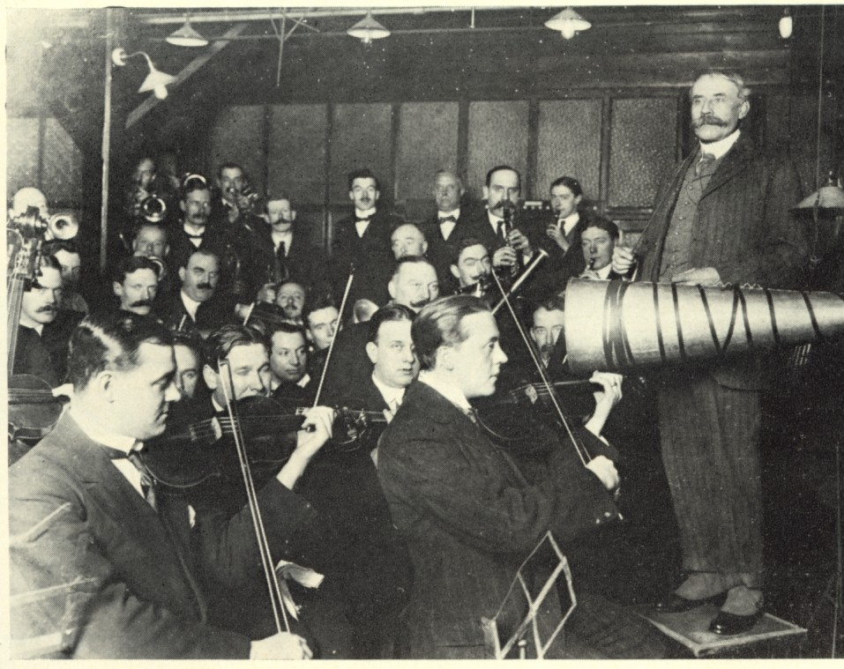
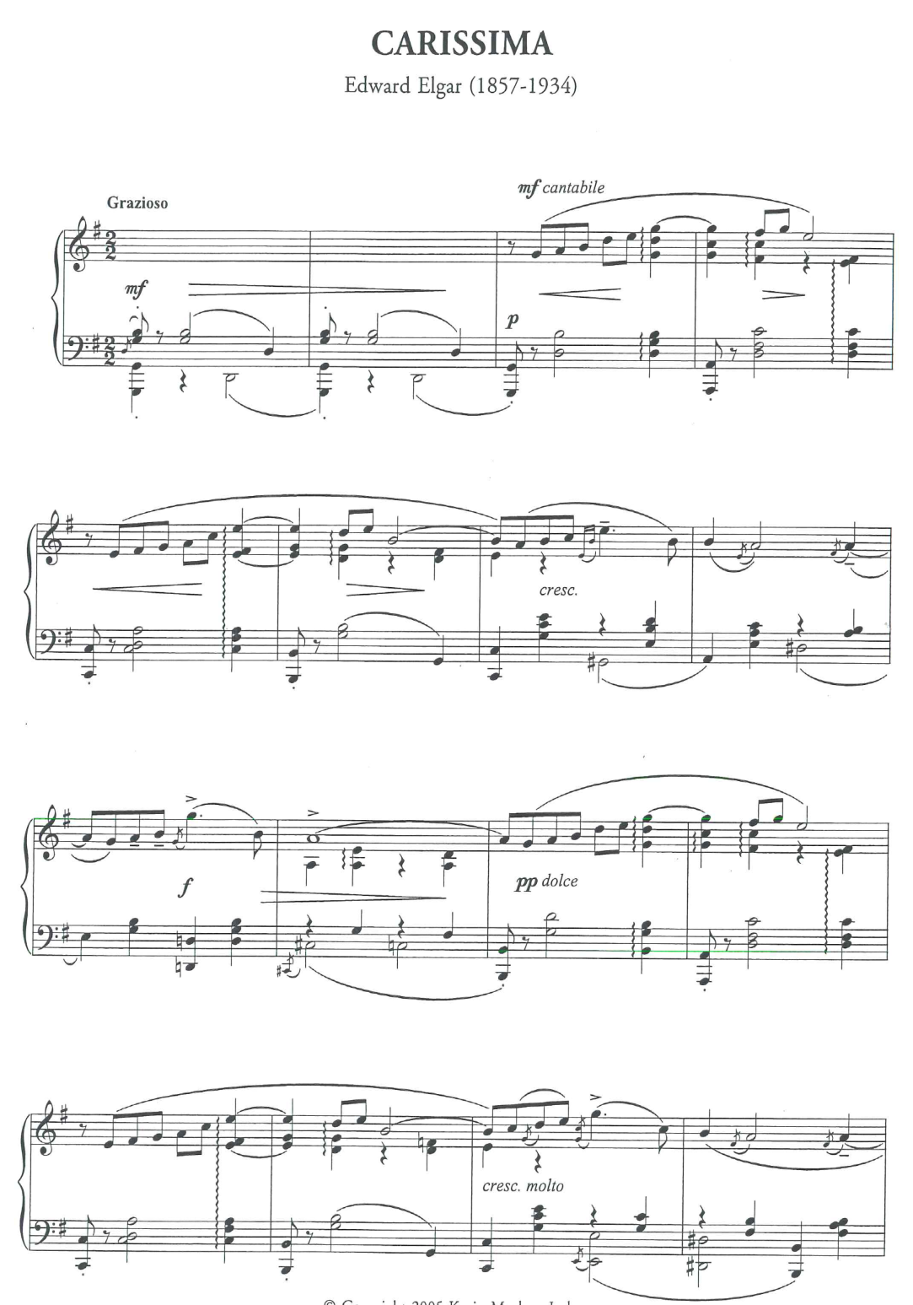
A picture of a session
A representation of the score
Edward Elgar: Carissima
Recorded 1914

Slide 3
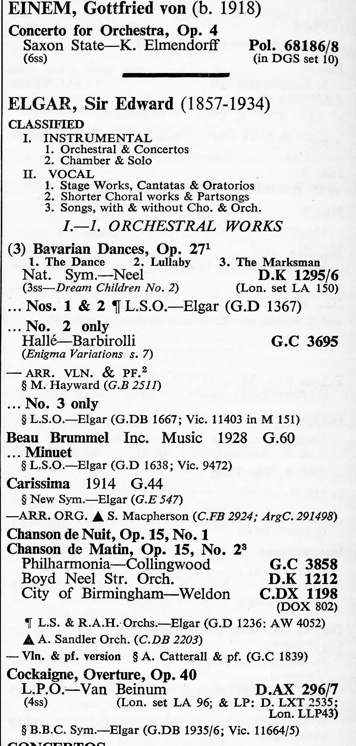
Francis F. Clough & G. J. Cuming: The world's encyclopaedia of recorded music

Slide 4
Claude Graveley Arnold: The Orchestra on Record 1896 – 1926

Slide 5
Edward Elgar: Carissima
Recorded 1929

Slide 6
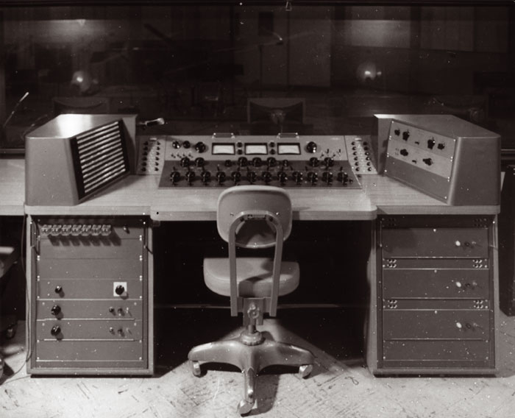
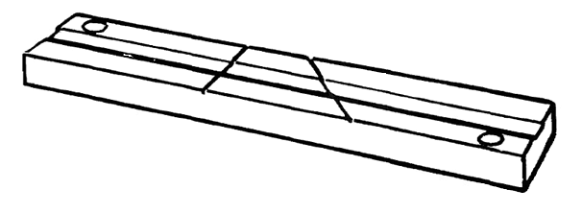
Manipulation of balance Electrical recording
Manipulation of time Tape recording
Manipulation of simultainety Multitrack recording

Slide 7
The paradox of High Fidelity:
The picture (of the session) was seemingly more and more transparent
But in reality the picture became more and more opaque
Like the transition from a photo to a painting?

Slide 9
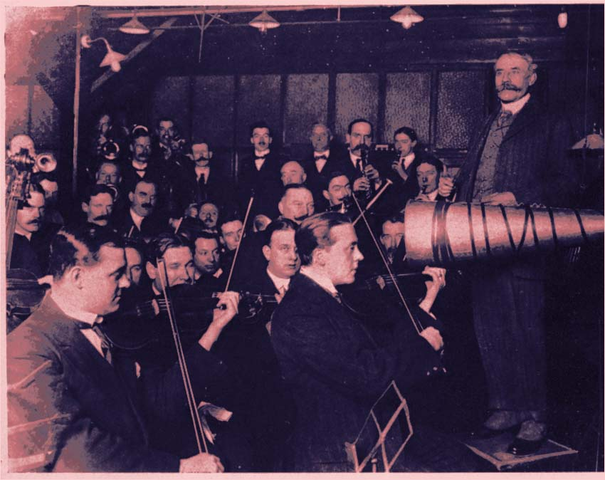

Slide 10
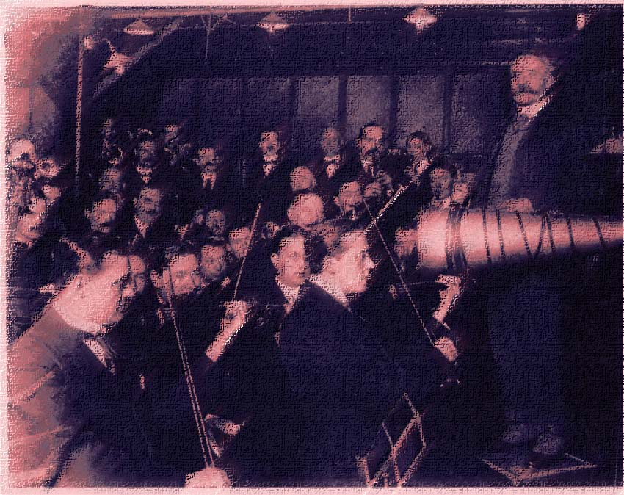

Slide 11
A picture of a session
A representation of the score
A studio construction

Slide 12
A studio construction
Electronic music
Theodore Grazyck: Rock Music
Lee Brown: Work of Phonography

Slide 13
From the Naxos booklet:
Edward Elgar: Carissima
Recorded 2004

Slide 14
The consequenses of taking WP seriously
WPs are something else than live music
WP’s origins are in principle not accessible to us
WPs have no history when listening
All phonograms are WPs

